Slide 1



Product Catalogue
Shrink Film
sales1@seahonest.com www.seahonest.com
YOUR PARTNER FOR ONE STOP PACKAGING MATERIALS

Slide 2
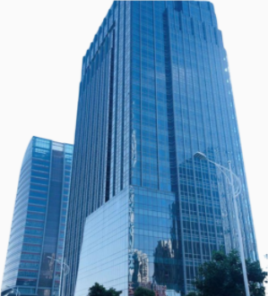
About Us
SEA HONEST FILM AND FOIL mainly engaged in manufacturing ,researching and offering the following products:
Labels
Shrink Sleeves
Sensitive Label Films
Roll Sleeves
Capsules
Battery
Packaging Film
Experience
Services
Innovation
Focus on plastic packaging materials industry since 2007. With rich experience in R&D.
We provide extensive expertise and solutions in the field of food and pharmaceutical packaging materials.
SEA HONEST Film and foil protects the environment through innovative products and pioneering system solutions.
Product Qualified Rate> = 99.9 %
Customer Satisfaction> =99.8 %
In-time Delivery Rate> = 99.9 %
Return Rate< = 0.08 %
YOUR PARTNER FOR ONE STOP PACKAGING MATERIALS

Slide 3




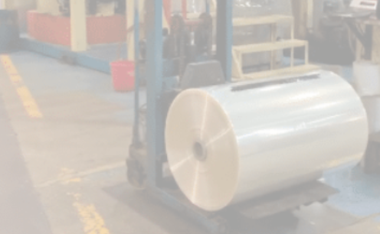
Company advantage
One-stop Purchase
Taiwan Raw Material
Provide One-stop purcahse service of PVC, PETg, BOPP, POF shrink film
High quality raw material reserves from Taiwan company
Work Shop
After sales Service
20 advanced production lines
Perfect quality inspection and technical team will help you solve any technical problems during your use
YOUR PARTNER FOR ONE STOP PACKAGING MATERIALS

Slide 4
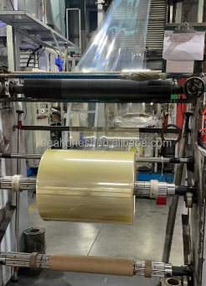
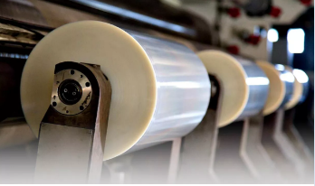
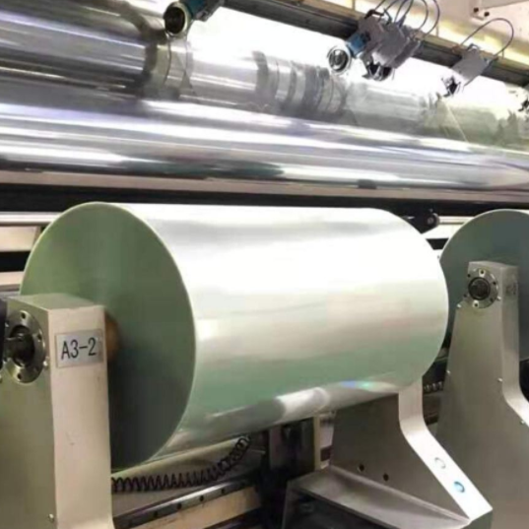
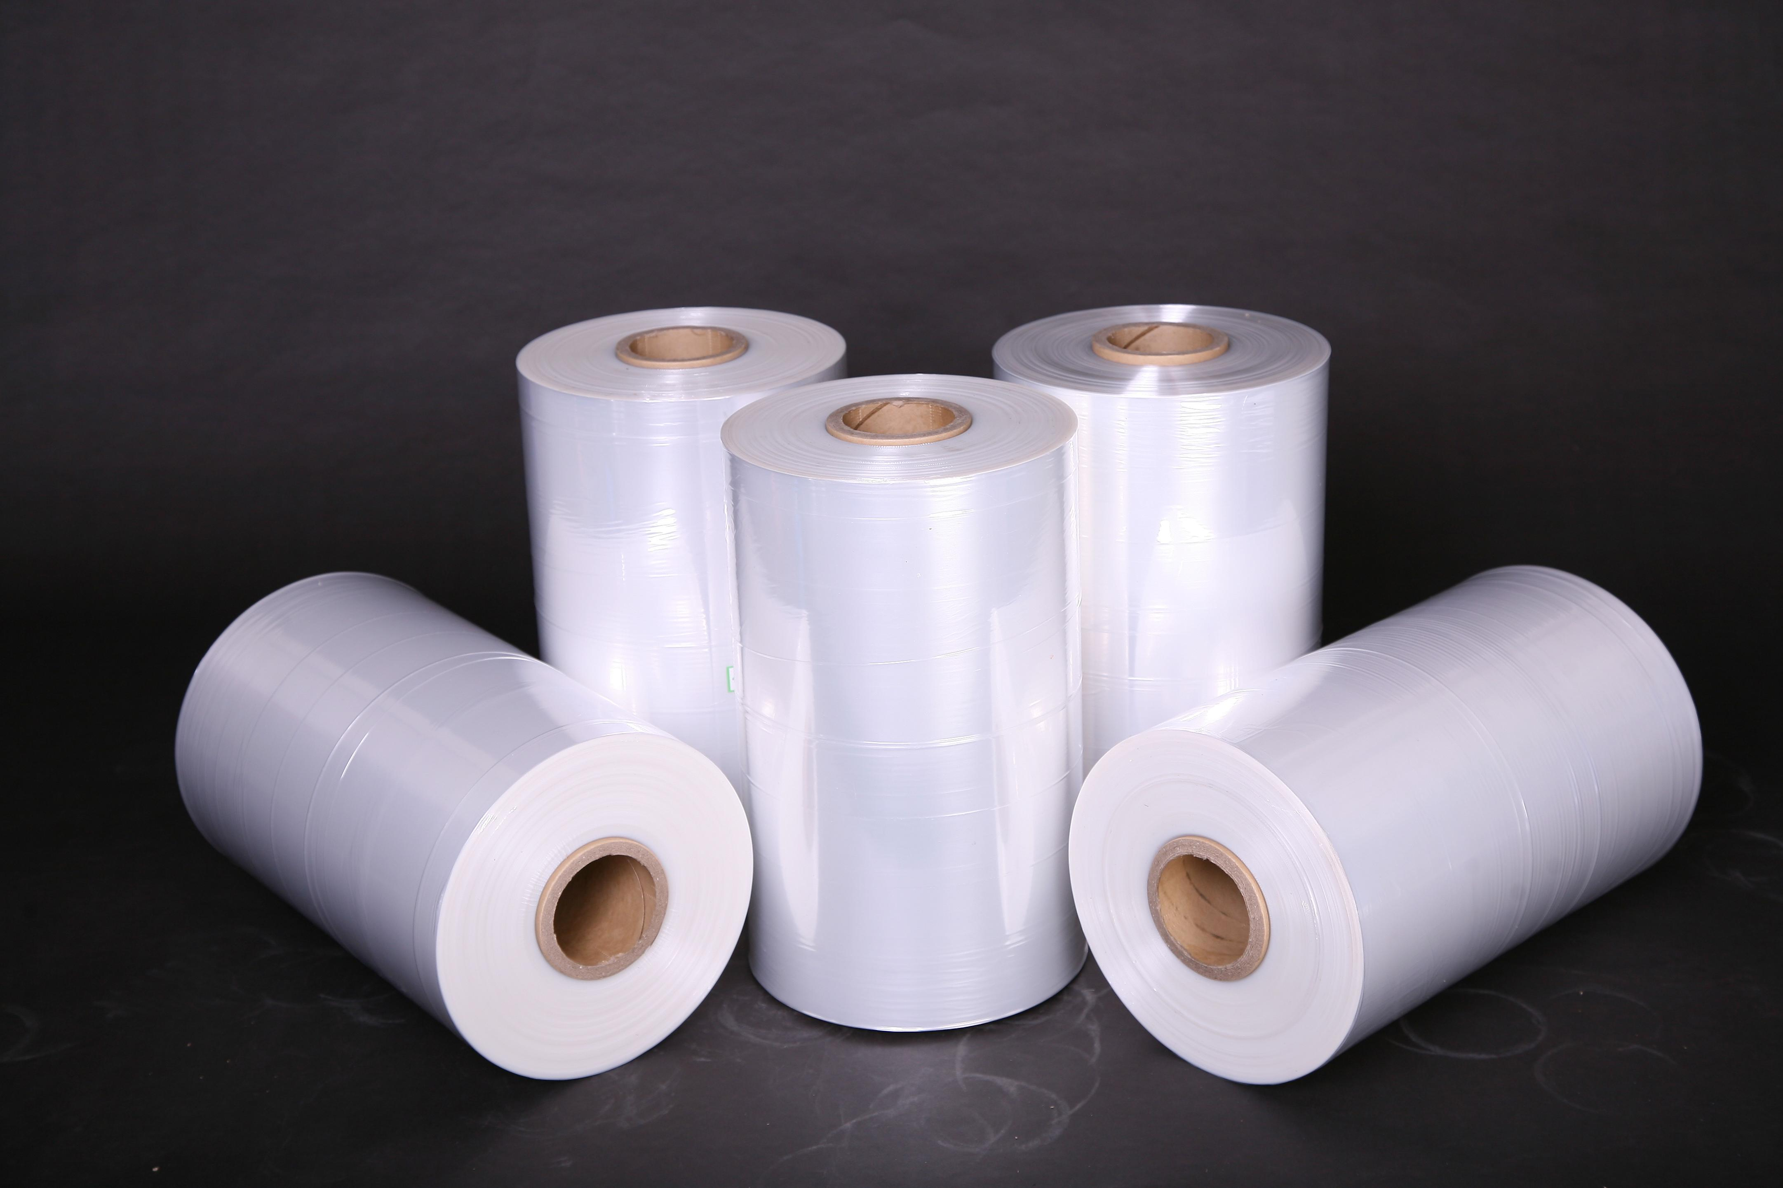
Product range
SHRINK FILM
BOPP FILM
PVC SHRINK FILM
POF SHRINK FILM
PETg SHRINK FILM
YOUR PARTNER FOR ONE STOP PACKAGING MATERIALS

Slide 5
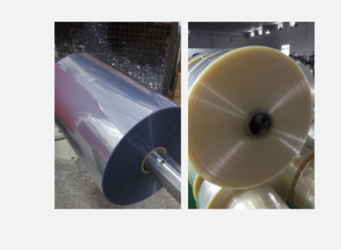

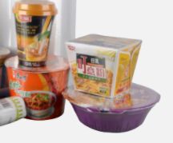
PVC Shrink Film
Single wound
Center folded
Sleeve
■ Product Feature
●High transparency
●High strength
●High Gloss
●Shrink easily and nice shrinking result
●Excellent for machine printing
●Good for damp-proof, dust-proof and shocking resistence
■ Product Appliction
☑ For label printing
☑ For packaging
INFO
ID | SHRINKAGE | THICKNESS | WIDTH | LENGTH | MOQ
76MM | 48%-55% | 30-150um | 50-1200MM | CUSTOMIZED | 500KGS

Slide 6
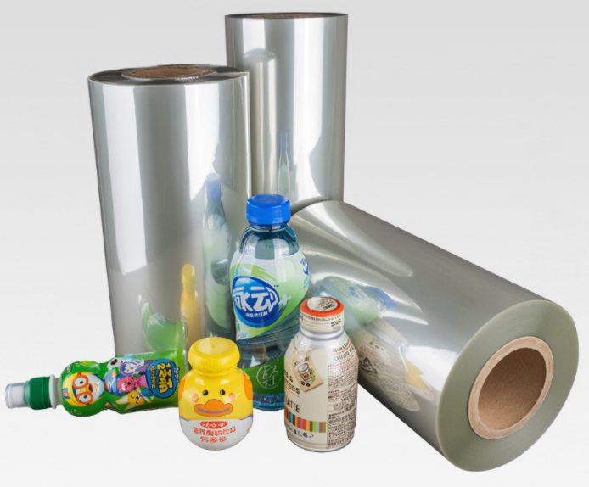

PETg Shrink Film
■ Product Feature
●Medium to super-high shrinkage properties
●Simple & multiple contours, high shoulder & narrow neck configurations
●Suitable for gravure, flexographic printing
●Use in steam, hot air, or infrared shrink tunnels
●Ideal for sleeve application machinery
●Excellent processability during printing, tube forming & shrinking
●High-impact strength
●High performance surface for enhanced printability allows multiple graphic schemes
■ Product Appliction
☑ For label printing
INFO
ID | SHRINKAGE | THICKNESS | WIDTH | LENGTH | MOQ
76MM | 65%-75% | 30-60um | 50-1520MM | CUSTOMIZED | 500KGS

Slide 7
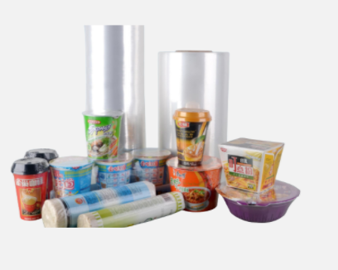
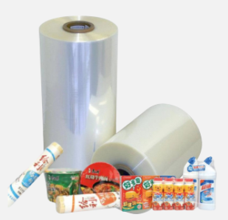
POF Shrink Film
Single wound
Center folded
Tube
■ Product Feature
●Environmental protection with high quality.
●High seal strength
●Sealed packaging to prevent from ash and warm
●Lightness,toughness, flexibility and even thickness
●High shrinkage ratio
●Fine heat sealing performance
■ Product Appliction
☑ For Packaging
INFO
ID | DESTINY | THICKNESS | WIDTH | LENGTH | MOQ
76MM | 0.922 | 10-30um | 100-2200MM | MAX 3100M | 500KGS

Slide 8
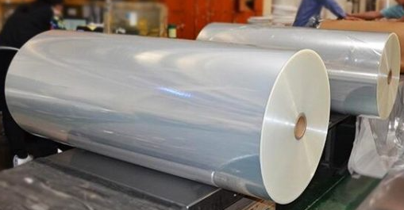
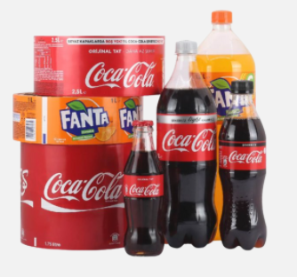
BOPP Film
■ Product Feature
●Suitable for heat seal or cold seal applications
●Suitable for single web or laminate structures
●Suitable for HFFS, VFFS and bag making
●Compatible with most print & ink systems
●Excellent transparency and print receptivity
■ Product Appliction
☑ IML-Blow Molding
☑ IML-Injection Molding
☑ Heat Sensitive Label Film
☑ Courier Envelope Film
☑ Pearlized Film
☑ OPP Film for Flower Pakcing
☑ Light Reflection Film
☑ Pearl Film
☑ Synthetic paper as consumable
☑ Synthetic Paper as Label
☑ Construction Film
☑ Facemask Film
INFO
ID | DESTINY | THICKNESS | WIDTH | LENGTH | MOQ
76/152MM | 0.65-0.9 | 9-80um | 200-2200MM | CUSTOMIZED | 500KGS

Slide 9
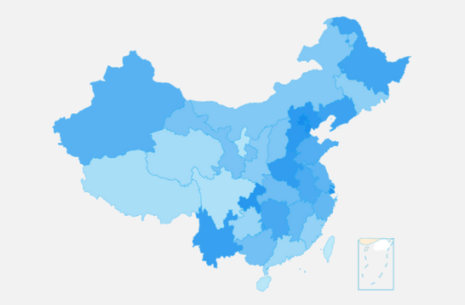

SEA HONEST Branch
QINGDAO:
QINGDAO HAIYUE NEW MATERIALS TECHNOLOGY CO.,LTD
ZIBO:
SHANDONG ENYOU NEW MATERIALS TECHNOLOGY CO.,LTD
HONGKONG:
SEA HONEST FILM AND FOIL CORPORATION LIMITED
YOUR PARTNER FOR ONE STOP PACKAGING MATERIALS

Slide 10





Contact us
Office Address:
Manufacturer-No 1, Lutai Road, Zhangdian District ,Shandong Provice, China (Mainland)
Trading Office-1 / F East Building No. 45 Beijing Road Qianwan Bonded Port Area, Qingdao City, Shandong Province,China(Mainland)
Sales Dept:
Lucy Song
Tel: +86-13285338893
Whatsapp/Wechat: +13285338893
Mail: sales@seahonest.com
Service Dept:
Aggie Wang
Mail: service@seahonest.com
Company Info:
Tel: +86-533-8170778
Mail: sales@seahonest.com
Web: https://www.shrinkfilm-roll.com/
follow us
YOUR PARTNER FOR ONE STOP PACKAGING MATERIALS

