Slide 1


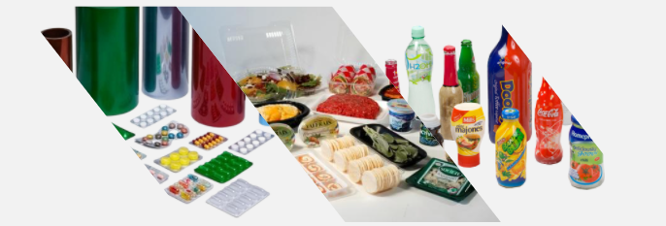
Product Catalogue
---Pharma package materials
sales@seahonest.com www.seahonest.com
YOUR PARTNER FOR ONE STOP PACKAGING MATERIALS

Slide 2
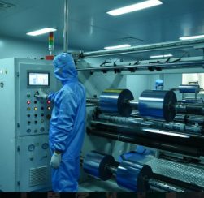
About Us
SEA HONEST FILM AND FOIL mainly engaged in manufacturing ,researching and offering plastic packaging films like Pharma packaging film:
PVC film
PVC/PVDC
PVC/PE for oral liquid
PVC/PE for suppository
PVC/Aclar
PTP alu foil
Alu alu foil
Strip foil
Tropical blister foil
MoistCatch Sachet or Pouch Foil
Stick Pack Film
Child-Resist Packaging
MoistCatch Cold Form Foil
Sachet and Pouch Foil
Experience
Services
Innovation
Focus on pharma package materials industry since 2007. With rich experience in R&D.
We can provide one-stop purchasing of pharma package materials
SEA HONEST film and foil improves quality control through innovative products and pioneering system solutions.
Today, the company continues to evolve in response to changing environmental challenges and societal needs, and we are committed to delivering quality products and services to our customers and communities.
YOUR PARTNER FOR ONE STOP PACKAGING MATERIALS
.

Slide 3
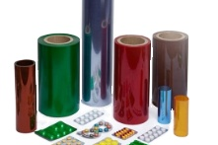
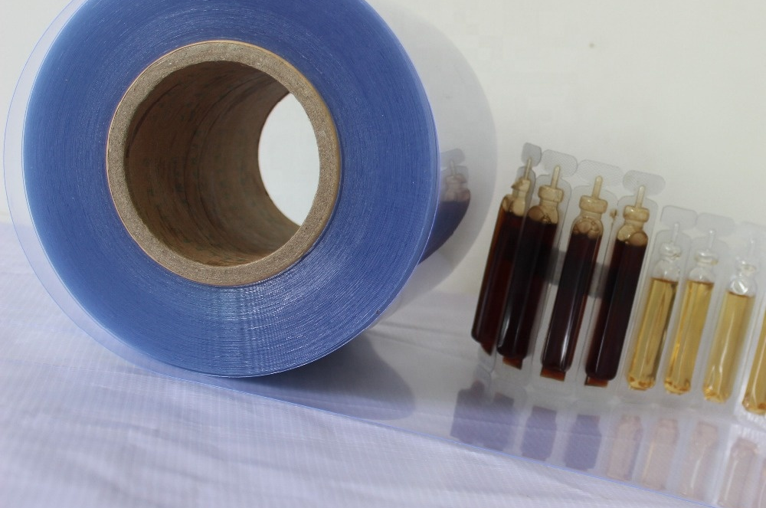
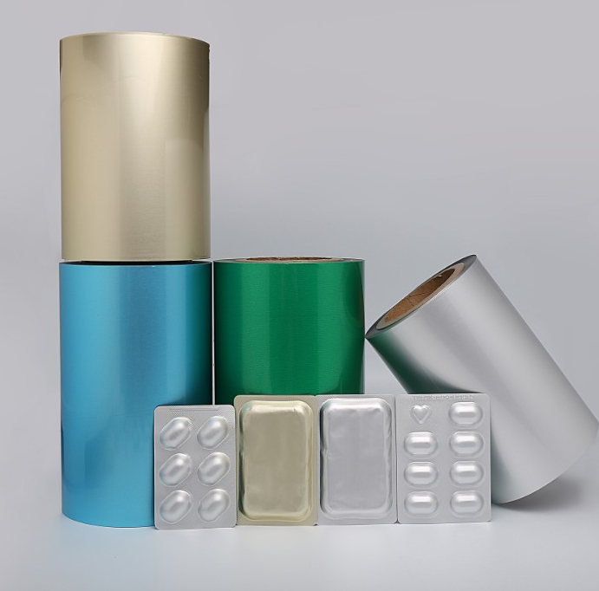
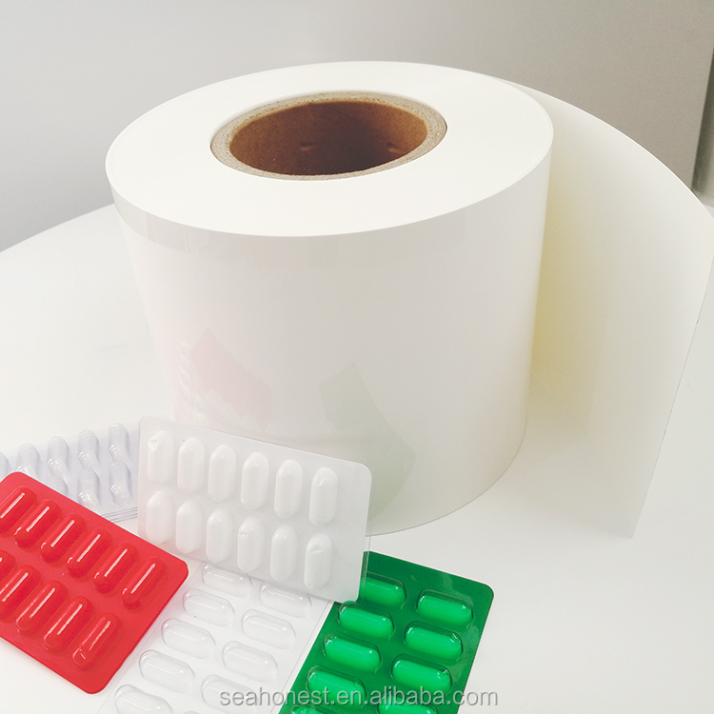
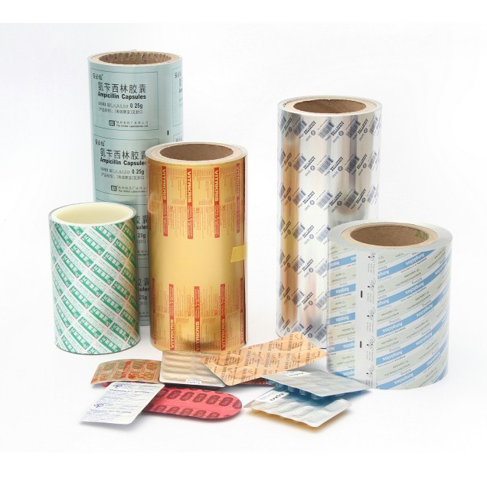
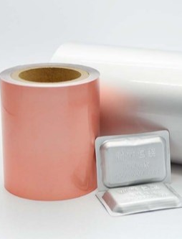
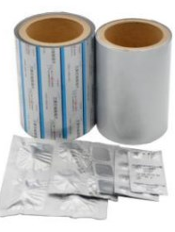
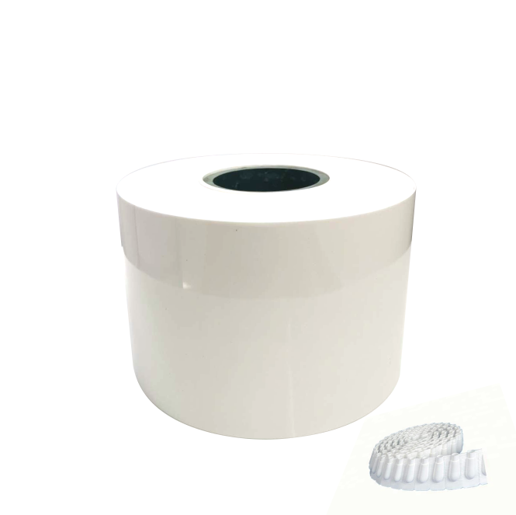
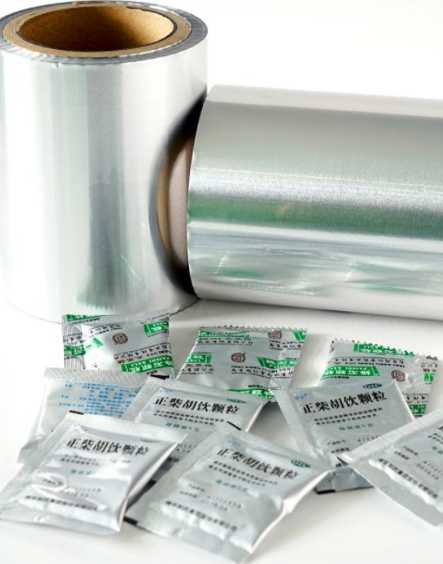
Product range
Pharma Packaging Materials
YOUR PARTNER FOR ONE STOP PACKAGING MATERIALS

Slide 4
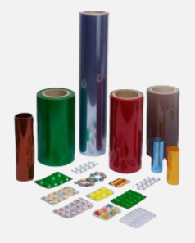
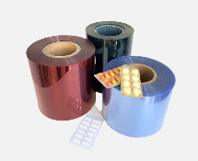
PVC film
Pharma grade PVC film
■ Advantage
●High transparency, bright surface luminance.
●Smooth surface, uniform thickness.
●Few hydrological veins, few crystal points.
●No smell and non-toxic.
●Can easily be thermoformed, printed, and folded
●All colors transparency
■ Product Description
It is a widely used product in the Pharmaceutical industry. Owing to its properties, it is mainly used in blister packing of tablets, capsules, pre-filled syringes, ampoules and medical devices.
Item | Color | Thickness | Width | ID
PVC film | All colors can be customized | 0.25mm,0.3mm,0.35mm or customized | Slitted:70-300 mm; Jumbo Roll:500-1600mm | 76/152mm
YOUR PARTNER FOR ONE STOP PACKAGING MATERIALS

Slide 5
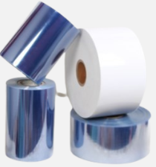

PVC/PVDC film
Structure:Multi-layer blister films based on PVC are often used for pharmaceutical blister packaging, whereby the PVC serves as the thermoformable backbone of the structure. PVC layer can be colored with pigments and/or UV filters. Polyvinylidene chloride (PVDC)–coated PVC
■ Advantage
●PVDC emulsion is 100% imported from europe.
●Crystallinity is strictly controlled.
●Online detection, offline rejection.
●Rapid delivery.
●High barrier.
●Can easily be thermoformed.
■ Product Structure
☑ PVC layer
☑ PVDC coating .
Structure | WVTR g/(m²•24h) | OTR cm³/(m²•0.1MPa)
PVC250 | ≤3.50 | ≤20.0
PVC250/PVDC40g | ≤0.80 | ≤0.90
PVC250/PVDC60g | ≤0.60 | ≤0.80
PVC250/PVDC90g | ≤0.40 | ≤0.75
PVC250/PVDC120g | ≤0.35 | ≤0.45
YOUR PARTNER FOR ONE STOP PACKAGING MATERIALS

Slide 6
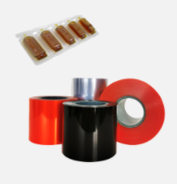

PVC/PE for oral liquid
Used mostly in the Pharmaceutical industry, PVC/PE is suitable for Oral liquid packaging, suppository packaging and other large size tablets/capsules where flexibility and deep draw packing is required.
■ Advantage
●Oxygen, water vapor and aroma barrier.
●Free from plasticisers and heavy metals.
●High gloss and outstanding clarity.
●Wide range of transparent and opaque colours.
●Outstanding thermoforming properties.
●High quality heat-sealing properties & flexibility.
■ Product Structure
☑ Duplex blister film is PVC,.
☑ Laminated with PE layer.
Item | Color | Thickness | Width | ID
PVC/PE for oral liquid | All colors can be customized | 0.25/0.05 (0.3)mm, 0.28/0.05 (0.33)mm or customized | 120/180/345mm or customized, Max Width:750mm | 76/152mm
YOUR PARTNER FOR ONE STOP PACKAGING MATERIALS

Slide 7
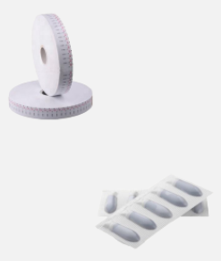
PVC/PE for suppository
Used mostly in the Pharmaceutical industry, PVC/PE is suitable for Oral liquid packaging, suppository packaging and other large size tablets/capsules where flexibility and deep draw packing is required.
■ Advantage
●Oxygen, water vapor and aroma barrier.
●Free from plasticisers and heavy metals.
●High gloss and outstanding clarity.
●Wide range of transparent and opaque colours.
●Outstanding thermoforming properties.
●High quality heat-sealing properties & flexibility.
■ Product Structure
☑ Duplex blister film is PVC,.
☑ Laminated with PE layer.
Item | Color | Thickness | Width | ID
PVC/PE for suppository | White, Yellow | 0.13-0.18mm or customized | 50-750mm | 76/152mm
YOUR PARTNER FOR ONE STOP PACKAGING MATERIALS

Slide 8
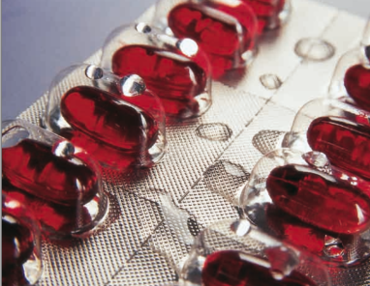
PVC/Aclar Laminates
PVC/Aclar@(PVC/PCTFE, PVC/PE/PCTFE) is thermoformable blister films offering high barrier to moisture, provides ten times more moisture-proof protection than transparent films such as PVC and polypropylene and completely isolate function.
Whether you require mid, high, or ultra-high moisture barrier, there is an Aclar product available to provide you with the optimum balance of performance and economics for your application.
■ Advantage
●Bio-chemically inert,chemical-resistant,non-flammable,and plasticizers and stabilizers free
●Process within the same range as other thermoforming films.
●Highly moisture-barrier properties to protect each individual tablet or capsule“pocket”
●No Yellowing, Crystal-clear performance, Up to 90% Less haze
●Excellent economical for packaging, logistic and warehousing. Maximum extend the shelf life.
■ Duplex: PVC/PCTFE
PVC/Aclar® film |  | Structure | Thickness | Measure Unit | WVTR
1 | Aclar®160 | PCTFE/PVC250 | PCTFE：15um | g/(m2·24h) | ≤0.35
2 | Aclar®20e | PCTFE/PVC250 | PCTFE：20um | g/(m2·24h) | ≤0.27
3 | Aclar®2000 | PCTFE/PVC250 | PCTFE：51um | g/(m2·24h) | ≤0.11
4 | Aclar®3000 | PCTFE/PVC250 | PCTFE：76um | g/(m2·24h) | ≤0.08
5 | Aclar®4000 | PCTFE/PVC250 | PCTFE：102um | g/(m2·24h) | ≤0.06
YOUR PARTNER FOR ONE STOP PACKAGING MATERIALS

Slide 9
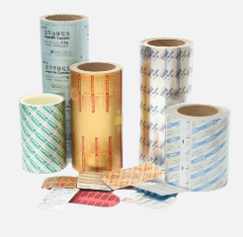
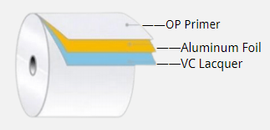
PTP Alu foil
PTP Alu foil can be heat-sealed with PVC, PVC/PVDC, Alu alu foil and other materials to package tablets, capsules and other tablets
■ Advantage
●A variety of anti-counterfeiting technologies are available.
●Online detection,offline rejection.
●Positove and negative precise overprint.
●Multiple opening methods,multiple child protection designs.
●We have Electronic axis foil printing machine which is rare in china.
■ Product Structure
☑ OP Primer.
☑ Aluminum Foil.
☑ VC Lacquer.
Item | HSL | Thickness | Width | ID
PTP Alu foil | 3-4g or 6-8g | 0.018-0.040 mm | 50-1000mm | 76/152mm
YOUR PARTNER FOR ONE STOP PACKAGING MATERIALS

Slide 10
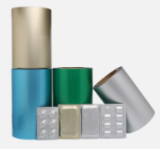
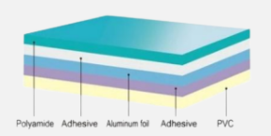
Cold form alu foil
Cold form alu foil for blister package
■ Advantage
●100% barrier to moisture,air,gases,light.
●Maximum fracture-free forming capabilities ensures “zero defect”.
●Superior process results in long term de-lamination resistance.
●Wide range of color and print options.
●Superior forming characteristics.
●Excellent thermal stability.
■ Product Structure
☑ OPA/AL/PVC
Item | Structure | Thickness | Width | ID
Cold form alu foil | OPA/ALU/PVC | 130-200mic | 50-810mm | 76/152mm
YOUR PARTNER FOR ONE STOP PACKAGING MATERIALS

Slide 11
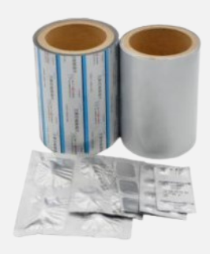
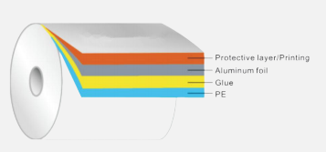
Strip foil
Pharmaceutical tablets, pills, and capsules, drugs that is sensitive to UV rays. trip foil is composed of aluminum foil and PE film, with high barrier property and can effectively prevent moisture and light. Greatly improve the protective for drugs (tablets, pills and capsules), extend the shelf life.
■ Advantage
●Highly barrier for vapor, oxygen, gas and light with good performance
●Easy tear ability and can be gently torn up from any direction.
●Each tablet can be individually packaged and protected.
●Internal friction coefficient control is accurate.
■ Product Structure
☑ Protective layer/Printing.
☑ Aluminum Foil.
☑ Glue.
☑ PE.
Item | Structure | Thickness | Width | ID
Strip foil | Alu/PE | 60µm~120µm | 80mm-900mm | 76/152mm
YOUR PARTNER FOR ONE STOP PACKAGING MATERIALS

Slide 12
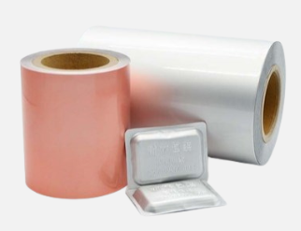
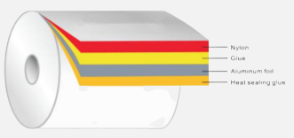
Tropical blister foil
PA/AL/VC Tropical blister foil (AL-Plastic-AL) is a creative and improved approach for packaging of PVC blister. It is a combination of thermo-formed blister and Formpack. It consists of a cold-modulable
Plastic-aluminum composite similar to that used for Alu-Alu blister. The goods filled into the plastic blister are therefore hermetically sealed between the top foil and the cold-formed laminate blister and optimally protected against moisture, light, gases and aroma influences
■ Advantage
●Enhance the barrier for moisture, light, oxygen, gases and aroma influences,extend the shelf life.
●Economic efficiency for packaging, logistic and warehousing, than Cold formed foil and superior than the sachet packaging too, even almost in the same cost.
●Customized print ability, embossed with a product name or company logo, Enhance the Product Brandattraction.
■ Product Structure
☑ Nylon.
☑ Glue.
☑ Aluminum Foil.
☑ Heal sealing glue.
Item | Structure | Thickness | Width | ID
Tropical blister foil | Ny25/AL65/VC | 90µm+10% | 50mm-1000mm | 76/152mm
YOUR PARTNER FOR ONE STOP PACKAGING MATERIALS

Slide 13
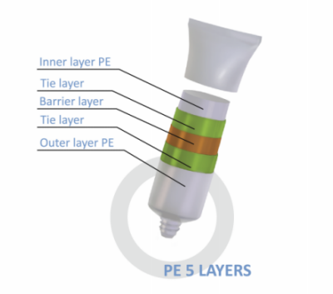
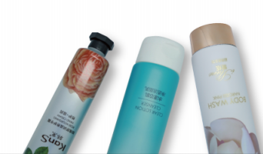
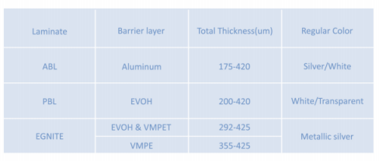
Laminated Tubes
Mouth care
Holding leading market share in various countries, our global partners include Colgate-Palmolive, Unilever，
Procter & Gamble, and Herrington.
Based on diverse customer needs, Assol offers
costomized packaging solutions including sheet structur, tube diameter, sheet color, and printing.
Medicine and Health
It is widely used in the packaging of pharmaceutical products such as eye gels, topical skin products, burn
ointments, and hemorrhoid creams.
Food
The tubes can withstand temperatures up to 90°C.
Composite tubes are used in food packaging for condensed milk, chili sauce, wasabi, and various sauces and jams.
Home Care 」
Aesol tubing features a high-barrier sheet structure that protects ointments containing oils and active ingredients. It features a specially designed long, pointed nozzle and an easy-to-twist end.
Widely used in industrial applications such as adhesives, lubricants, pigments, and shoe polish.
Cosmetics
Product applications include hand creams, facial
cleansers, BB creams, conditioners, shampoos, sunscreens, and other skincare products.
■ Product Structure
YOUR PARTNER FOR ONE STOP PACKAGING MATERIALS

Slide 14
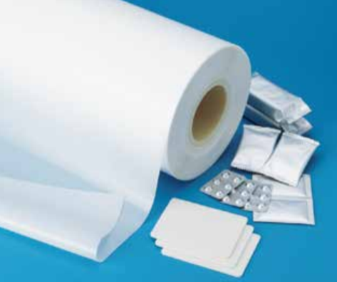
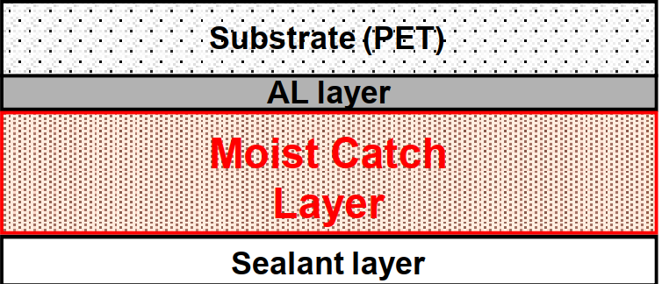
MoistCatch Sachet or Pouch Foil
The Laminated foil include special PE layer, PE layer combine resin with desiccants. It have function as moisture absorbe. MoistCatch laminated foil can make perfect solution for moisture-reactive products.
■ Advantage
●The most effective barrier capabilities, superior drying capabilities, enhance active ingredients protection, sensitive products for moisture or hygroscopic.
●Moisture and gad absorbents dispersed within resin at high concentration rate.
●Maintain high moisture-absorption performance for a long shelf life.
●Excellent barrier to enhance active ingredients protection, and sensitive products for moisture or hygroscopic.
●Extend pharmaceutical product shelf life.
■ Application
Probiotics (Active bacteria moisture sensitive), Diagnostic Strips.Blood Glucose Test Strips,Drugs-OTC,PET care, Medical device, Electronic equipment.
Item | Structure | Thickness | Width | ID
PTP Alu foil | PET/AL/PE | 70µm~150µm | 50mm-600mm | 76/152mm
YOUR PARTNER FOR ONE STOP PACKAGING MATERIALS

Slide 15
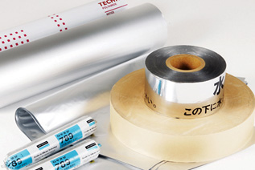
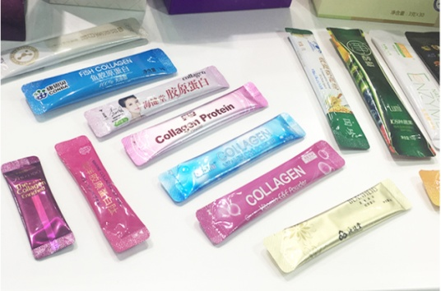
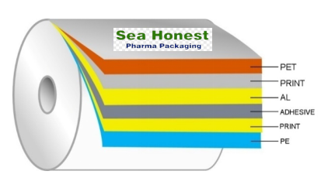
Stick Pack Film
Stick pack is for using the minimum amount of film contains the entire single-serving, Perfect for single servings. Stick packaging gets its name from its shape, which is long and skinny like a stick of gum. Stick Packs are cylindrical shaped pouches that are used for single serve dosage. quire 10 % – 40 % less packaging material than equivalent rectangular or square pouches, Stick packs are especially valuable for new product introduction & promotions. A unique unit dose application stick packs easily deliver powders, liquids & gels better than rectangles
■ Advantage
●The most effective barrier capabilities, superior drying capabilities, enhance active ingredients protection, sensitive products for moisture or hygroscopic.
●Moisture and gad absorbents dispersed within resin at high concentration rate.
●Maintain high moisture-absorption performance for a long shelf life.
●Excellent barrier to enhance active ingredients protection, and sensitive products for moisture or hygroscopic.
●Extend pharmaceutical product shelf life.
■ Application
☑ PET.
☑ Print.
☑ Alu.
☑ Print.
☑ PE.
Item | Structure | Length | Width | ID
Stick Pack Film | PET/AL/PE | 500-3000meter | 50mm-600mm | 76/152mm
YOUR PARTNER FOR ONE STOP PACKAGING MATERIALS

Slide 16
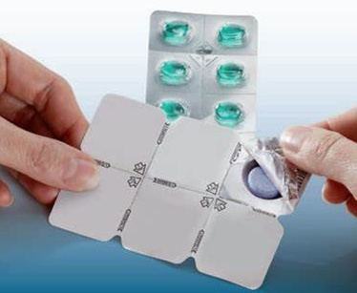
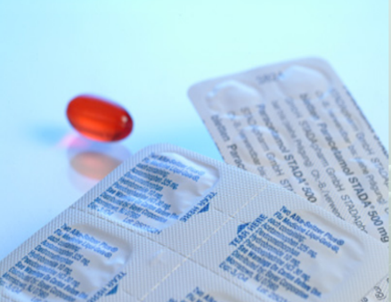
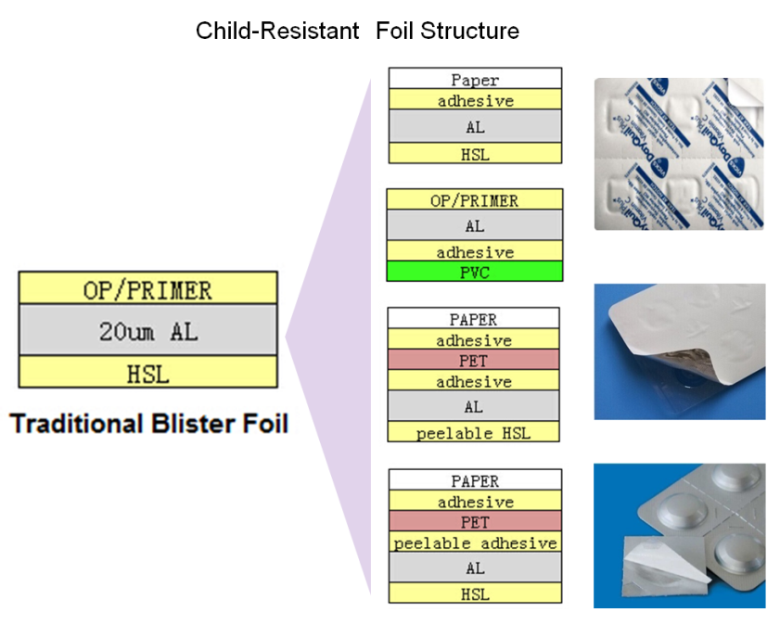
Child-Resist Packaging
Child-Resist Packaging called "CR Packaging", “CPR Packaging”, It is special packaging used to reduce the risk of children ingesting hazardous materials, often accomplished by tuse of a special child-resistant special child-resistant closure “safety cap”, and certain unit-dose blister packaging(e.g., puncture-resistant and peel-push blisters).
We provide a wide variety of child resistant blister lidding laminates in both peelable or peel-push varieties. And the most economical product customized to your requirements.
■ Advantage
●Keep Your Child Safe With Child-Resistant Packaging.
●CR films prevent accidental ingestion by making blister pack difficult to open.
●Tablets/Capsules are individually packed in CR pretested blister pockets.
●High bond-integrity and anti-rapture strength (Significantly higher than mono foil lidding )
Purposely makes CR lidding difficult.
■ Product Structure
☑ PET.
☑ Print.
☑ Alu.
☑ Print.
☑ PE.
Item | Structure | Thickness | Width | ID
Stick Pack Film | Paper/AL, OP/AL/PVC, Paper/PET/AL | 50µm~150µm | 50mm-900mm | 76/152mm
YOUR PARTNER FOR ONE STOP PACKAGING MATERIALS

Slide 17
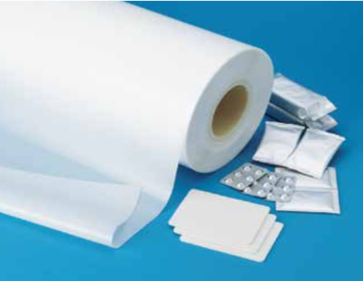
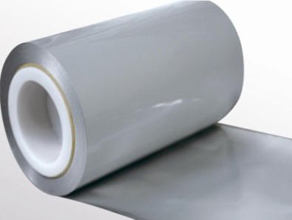
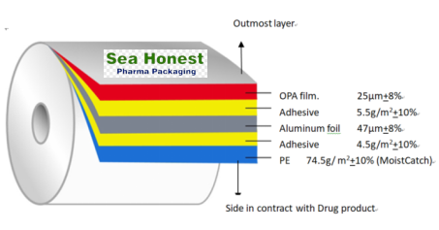
MoistCatch Cold Form Foil
MoistCatch Cold Form Foil, inside PE layer combine resin with desiccantswhich can give packaging absorbing moisture function, which make perfect solution for highly moisture-sensitive products, against degradation from moisture, oxygen and light – factors which can lead to loss of stability, shortened shelf-life or ineffective drug delivery.
■ Advantage
●The most effective barrier capabilities, superior drying capabilities, enhance active ingredients protection, sensitive products for moisture or hygroscopic
●Extend pharmaceutical product shelf life.
●Moisture and gas absorbents dispersed within resin at a high concentration rate.
●Long-lasing absorbing property, the integrated desiccant solution keeps the cavity dry (<10% r.h.) for 5 years in40°C / 75% r.h. conditions
■ Product Structure
☑ OPA
☑ Adhesive.
☑ Aluminum foil .
☑ Adhesive.
☑ PE.
Item | Structure | Thickness | Width | ID
MoistCatch Cold Form Foil | OPA 25/AL47/PE80 | 160µm | 50mm-1050mm | 76/152mm
YOUR PARTNER FOR ONE STOP PACKAGING MATERIALS

Slide 18
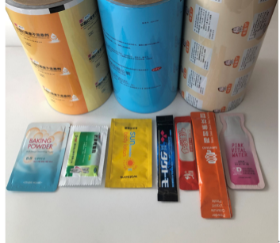
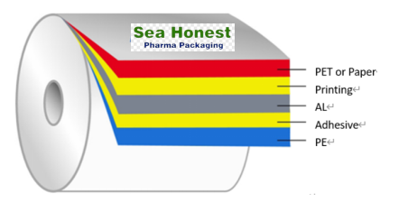
Sachet and Pouch Foil
Sachet film is good barrier to saving the aroma, resisting moisture and oxygen, printable, having trait of good heat ealability and high strength. we supply innovative laminates to satisfy customer’s specific needs to attain more reliable and economical packaging solution.
■ Advantage
●Reliable color management system, online detection, offline rejection
●Very suit for the latest wide-width high-speed packaging machine.
●3)Prevent the permeation of water, water vapor, oil, oxygen, aroma, flavor, gas, or light.
●Heat seal layer is tailored as per the characteristics of the packaging machine and the characteristic of the drug to reduce adsorption and migration.
■ Product Structure
☑ PET or Paper
☑ Printing.
☑ Al.
☑ Adhesive.
☑ PE.
Item | Structure | Thickness | Width | ID
Sachet and Pouch Foil | PET/AL/PE,Paper/AL/PE,AL/PE; Paper/PE | 50µm-150µm | 50mm-1050mm | 76/152mm
YOUR PARTNER FOR ONE STOP PACKAGING MATERIALS

Slide 19
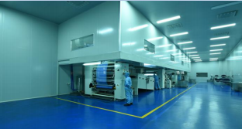
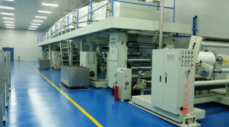
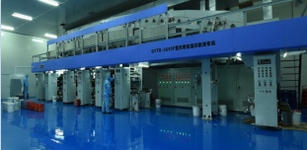
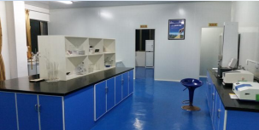
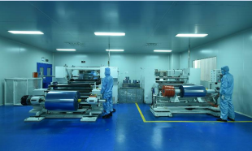
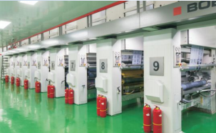
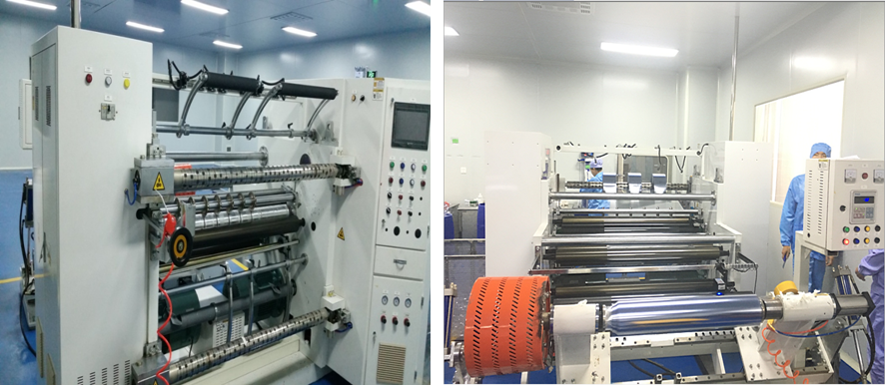
Production environment--100,000-level purification workshop
YOUR PARTNER FOR ONE STOP PACKAGING MATERIALS
.

Slide 20
Lab Equipment List
Name | Quantity | Usage
Water permeability tester | 1 | Testing of Water Vapor Permeability of Flexible Packaging Materials
Oxygen permeability tester | 1 | Oxygen permeability testing of flexible packaging materials
Gasphase chromatography | 2 | Used for the detection of residual solvent amount
Tensiometer | 4 | Used for the detection of peel strength, tensile strength and elongation
AT-FY | 2 | Test the physical properties of high-temperature cooking products
Low-power microscope | 1 | For material structure analysis
Friction coefficient meter | 2 | Dynamic and static friction coefficient of packaging materials
GBB-F | 3 | Dynamic and static friction coefficient of packaging materials
Electronic analytical balance | 2 | Gram weight (unit weight), amount of glue, chemical test, etc.
Environmental chamber | 3 | Used to test stability experiments
Microbial detector | 5 | Used for microbial configuration, storage, operation, etc.
Chemical testing instrument | 4 | Used for chemical test operation and reagent storage
Others | 7 | Various inspections
Total | 37 | QC central lab / on-site lab
YOUR PARTNER FOR ONE STOP PACKAGING MATERIALS

Slide 21
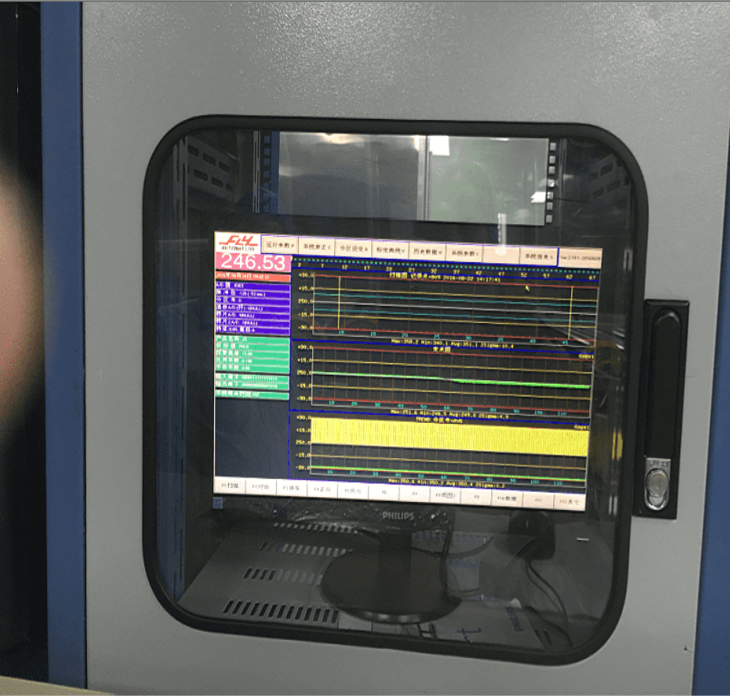
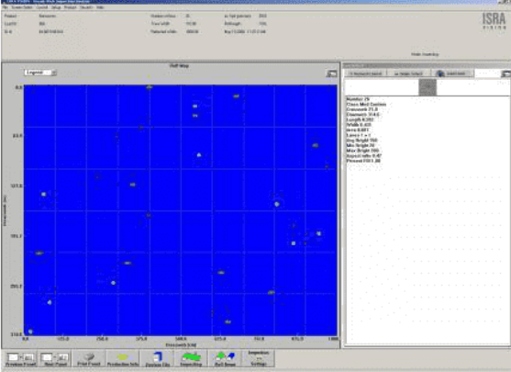




Quality Control
Automatic rolling, thickness tester
during producing
ISRA camera system
In process monitor
In process thickness control Frequently checked by QA
Quality Control In-Process
Setting parameter with authorized
people
YOUR PARTNER FOR ONE STOP PACKAGING MATERIALS
.

Slide 22

Product Traceability System
Trace the complete history of batch products

Slide 23


SQM System
IQC Process

Slide 24


In Process Inspection
IPQA日常检查
1. 过程检查/产品的规格/检查/目视检查
Process control, Product spec, Visual check
2、工艺规程
Process SOP
3、首检确认
First Test confirmation
4、异常的控制和反馈
Exception Avoidance and Feedback
5、纠偏行动的后续行动
CAPA
FG Release Process

Slide 25

Customer Compliant Handing

Slide 26


SEA HONEST Branch
QINGDAO:
QINGDAO HAIYUE NEW MATERIALS TECHNOLOGY CO.,LTD
ZIBO:
SHANDONG ENYOU NEW MATERIALS TECHNOLOGY CO.,LTD
HONGKONG:
SEA HONEST FILM AND FOIL CORPORATION LIMITED
YOUR PARTNER FOR ONE STOP PACKAGING MATERIALS

Slide 27





Contact us
Office Address:
Manufacturer-No.1 Lutai Road Zibo city Shandong Province China 255000
Trading Office-1 / F East Building No. 45 Beijing Road Qianwan Bonded Port Area Qingdao,China
Sales Dept:
Fred Wang
Tel: +86-13287083361
Whatsapp/Wechat: +86-13287083361
Mail: sales2@seahonest.com
Service Dept:
Aggie Wang
Mail: service@seahonest.com
Company Info:
Lucy Song
Tel: +86-5338170778
Mail: sales@seahonest.com
Web: www.seahonest.com
follow us
YOUR PARTNER FOR ONE STOP PACKAGING MATERIALS

