Slide 1


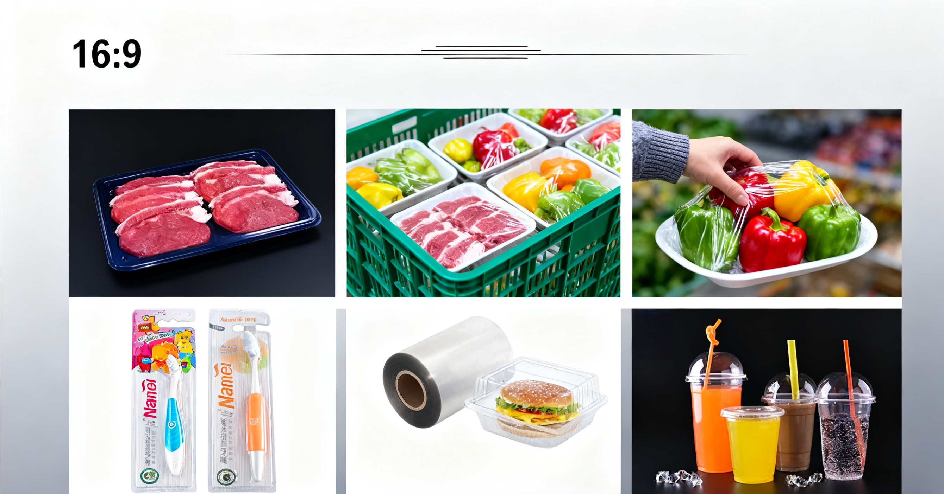
Product Catalogue
Consumer Packaging
sales1@seahonest.com www.seahonest.com
YOUR PARTNER FOR ONE STOP PACKAGING MATERIALS

Slide 2


About Us
SEA HONEST FILM AND FOIL mainly engaged in manufacturing ,researching and offering consumer packaging.
Following are our main products,which is mainly used for blister pack,
thermoforming, folding ect.
1. PVC
2. PET,PETG,GAG
3. PP
4. PS
5. PLA
6. PC
7. High barrier laminated film
Experience
Focus on infrastructure building materials
industry since 2004. With rich experience in R&D.
Services
We provide extensive expertise and solutions in the field of
infrastructure building materials.
Innovation
Elite New Materials
protects the
environment through innovative products
and pioneering system solutions.
We are keeping engaged in offering sustainable solutions to package and protect products in daily situations around the globe. And we understand our obligation and responsibility to champion a circular economy where plastics are a source of
valuable raw material.
Founded in 2004, we have total 26 production line, include 11 pvc line, 10 PET line, 5 PP,PS line. PVC 3450 tons/month ,PET 3000 tons/month, PP,PS 1000tons/month
YOUR PARTNER FOR ONE STOP PACKAGING MATERIALS

Slide 3




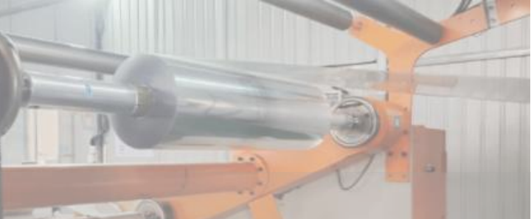
Company advantage
One-stop Purchase
Cost effective solution
Provide One-stop purcahse
service for consumer packaging
Use our wide-ranging expertise and
product knowledge to extend our product offerings and develop cost-effective
solutions that deliver our customers’ vision.
Production capacity
Total 26 production line, include 11 pvc
line, 10 PET line, 5 PP,PS line. PVC 3450 tons/month ,PET 3000 tons/month,
PP,PS 1000tons/month
High Standard
Apply the highest production and safety standards to deliver a quality product,
every time. With our state-of-the-art
manufacturing, we aim for 100% precision on every order.
YOUR PARTNER FOR ONE STOP PACKAGING MATERIALS

Slide 4

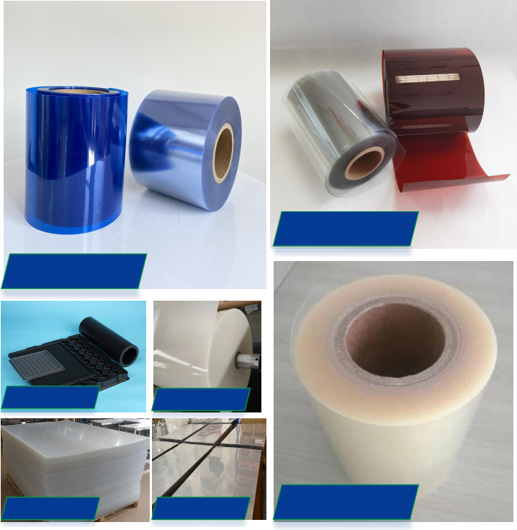
Product range
Consumer Packaging
PET Film
PLA Film
PVC Film
PS Film
PETG
PP Film
PC
YOUR PARTNER FOR ONE STOP PACKAGING MATERIALS

Slide 5
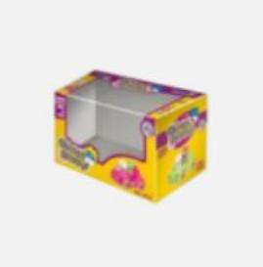

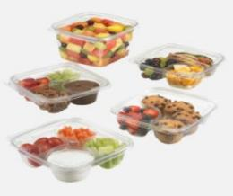
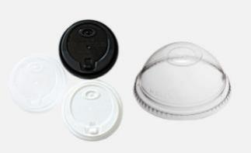
Product usage
Consumer Packaging
Toothbrush/Blister packaging
Suitable material: PVC, PETG,PET
Folding box
Suitable material: PVC,PET,PLA
Food container/Tray
Suitable material: PET,PETG,PP,PLA
Cup lids
Suitable material: PET,PP,PS
YOUR PARTNER FOR ONE STOP PACKAGING MATERIALS

Slide 6

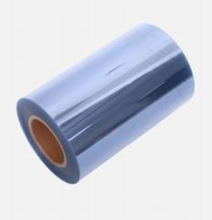

PVC
PVC rigid film
Thickness: 0.03-1mm
Width: 20-1600mm
. PVC Feature
●Dimensional stability -PVC thermoformed parts are not easy to shrink and deform after cooling stealing.
●High transparency - good light transmission, no impurities, no crystallization, no flow line
●Acid and alkali resistance -stable chemical performance and corrosion resistance
●Antistatic -suitable for blister packaging of electronic products
●Good strength -not easy to crack after being folded into a packaging box
. Product Usage
Blister pack,thermoforming
Egg tray, food tray,ampulous tray ect
Folding box
Printing
Configuration
Item | Thickness | Width | Color | ID
PVC Film | 0.03-1mm | 50-1600mm | Transparent, Black, White ect, color could be customized | 76/152mm

Slide 7
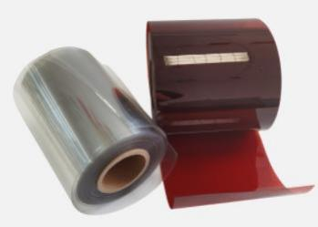

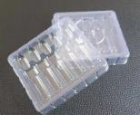
APET
PET Film
Thickness: 0.25-1mm
Width: 200-850mm
. PET Feature
●Non-toxic, 100% recyclable, and environmentally friendly .
●Roll type/Reel type and sheet type with 1 or 2 sides protection film
●High transparency,good prinitng and therforming performance
. Product Usage
Thermoforming and vacuum forming
Food tray,candy packaging ect
Ampulous tray
Folding box
Printing
Configuration
Item | Thickness | Width | Color | ID
PET Film | 0.25-1mm | 200-850mm | Transparent, Amber ect. Color could be customized | 76/152mm

Slide 8
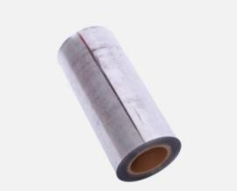

PETG
PETG Film
Thickness: 0.18-2 mm
Width: 400-1220mm
. PETG Feature
●Non-toxic, 100% recyclable, and environmentally friendly .
●High transparency,good prinitng and therforming performance
●Good toughness, impact resistance, could heat seal with paper ect to make blister
. Product Usage
Blister & Clamshell packaging
Food tray,candy packaging ect
Ampulous tray
Folding box
Printing
Configuration
Item | Thickness | Width | Color | ID
PETG Film | 0.18-2mm | 400-1220mm | Transparent, Amber ect. Color could be customized | 76/152mm

Slide 9
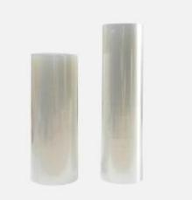
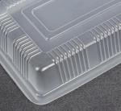
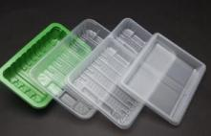
PP
PP Rigid Film
Thickness: 0.23-1.5mm
Max Width: 800mm
. PP Feature
●PP sheet has the characteristics of non-toxic, odorless, hygienic, high mechanical strength and good barrier properties, and can be used for packaging in industry, agriculture, fruit and other industries.
●Cold and heat resistant.Could be used for microwave
● Environment friendly
● Best thermal properties,Best Gas tightness
. Product Usage
Quick frozen products packaging
Cup Lids, food container
Folding box
Printing
Configuration
Item | Min Thickness | Max Width | Color | ID
PP Film | 0.23-1.5mm | 800mm | Nature color, High transparent ,Black ect, color could be customized | 76/152mm

Slide 10
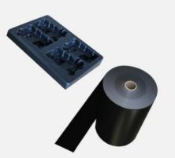
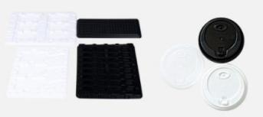
PS/HIPS
PS Rigid Film
Thickness:0.18-1.5mm
Width: 75-800mm
. HIPS Feature
●Low static electricity generation, suitable for packaging of products requiring low static electricity.
●It is easy to vacuum form, and the product has good anti-attack performance.
●It has good hygienic properties and can be directly contacted with food without causing harm or benefit.
●It is easy to be colored, and can be made into materials of different colors to produce vacuum covers of different colors.
●Good hardness, this kind of sheet material has better hardness compared with other sheet materials of the same thickness.
. Product Usage
Low static electricity generation (such as electronic products ...)
Hot and cold drink cup and cup lids
Configuration
Item | Thickness | Width | Color | ID
PS Film | 0.18-1.5mm | 75-800mm | White,Black ect, color could be customized | 76/152mm

Slide 11
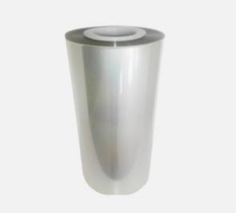
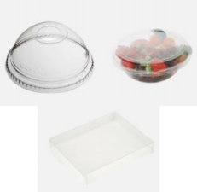
PLA
PLA/polylactic acid
Roll Thickness:0.2mm-2mm
Roll Width: 200-850mm
Sheet Thickness: 2-6mm
Sheet Width: 300-1250mm
. PLA Feature
●Easy thermoforming
●Reliable biological safety, biodegradability,Good mechanical properties and easy
processing
●High transparency and gloss
. Product Usage
Food trays,Medical trays
Cup lids
Cards
Paper file
Configuration
Item | Thickness | Width | Color | ID
PLA Roll | 0.2-2mm | 200-850mm | Clear, White,Black ect Color could customized | 76/152mm
PLA Sheet | 2-6mm | 300-1250mm | Clear, White,Black ect Color could customized | /

Slide 12
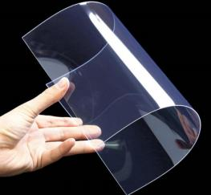
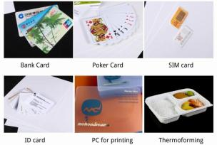
PC
PC,Polycarbonate Film
Thickness:0.1-1.5mm
Width: 950mm
. PC Feature
●High wear resistance,Low shrinkage, improved flatness
●Optimized textures for printing, hot stamping and lamination
● Tight gauge tolerance for controlled stack tolerance after lamination
. Product Usage
Bank Card, ID card
Printing
Thermoforming
Configuration
Item | Thickness | Width | Color | ID
PC Roll | 0.1-0.5mm | 950mm | Clear, White ect Color could customized | 76/152mm
PC Sheet | 0.5-1.5mm | 950mm | Clear, White ect Color could customized | /

Slide 13

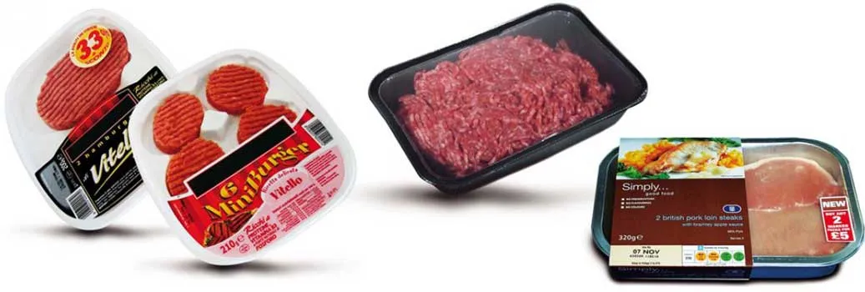
High barrier laminated film
Cosmetie,Pet medicine,perfume
and pesticide packing film
-PVC/PE rigid fim
-PET/PE rgid fim
-PVC/EVOH/PE high barrier composite fim
-PET/EVOH/PE high barier composite fim
-PET/PE lidding film
-PET/AL/PE lidding fim
-PET/AL/EVOH/PE lidding fim
Beef、mutton、seafood
and vegetables packing film
-PVC/PE cold-resistant rigid fim
-PET/PE rigid fim
-PET/EVOH/PE rgid fim
-PVC/EVOH/PE rigid fim

Slide 14

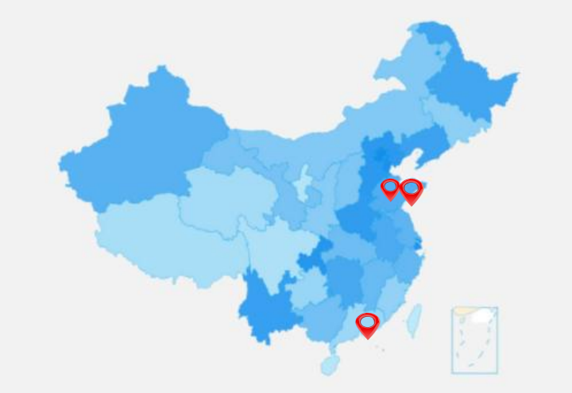



SEA HONEST Branch
QINGDAO:
QINGDAO HAIYUE NEW MATERIALS TECHNOLOGY CO.,LTD
ZIBO:
SHANDONG ENYOU NEW MATERIALS TECHNOLOGY CO.,LTD
HONGKONG:
SEA HONEST FILM AND FOIL CORPORATION LIMITED
YOUR PARTNER FOR ONE STOP PACKAGING MATERIALS

Slide 15






Contact us
Office Address:
Sales Dept:
Service Dept:
Company Info:
Manufacturer-No 1, Lutai Road, Zhangdian District ,Shandong Provice, China (Mainland)
Trading Office-1 / F East Building No. 45 Beijing Road Qianwan Bonded Port Area, Qingdao City, Shandong Province,China(Mainland)
Lucy Song
Tel: +86-13285338893
Whatsapp/Wechat: +86-13285338893
Mail: service@seahonest.com
Aggie Wang
Mail: service@seahonest.com
Tel: +86-533-8170778
Mail: sales@seahonest.com
Web: www.seahonest.com
follow us
YOUR PARTNER FOR ONE STOP PACKAGING MATERIALS

